Slide 1
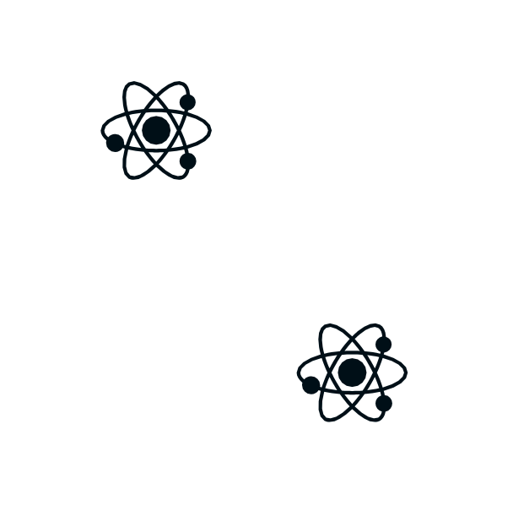
B LU E Q U B I T
C H A L L E N G E
The Logical Qubits

Slide 2
THE GOAL
Find the hidden bitstrings that appears with high probability hidden within special quantum circuits

Slide 3
OUR APPROACH
Optimization
Qiskit
Tket
Matrix Product State (MPS)
Rotation removal

Slide 4
EXAMPLE: PROBLEM 5
Initially only used Qiskit
We used both Qiskit and Tket one after another to optimize the code before we eventually managed to retreive the bitstrings with the highest probabilities.
Tket is highly efficient in reducing 2-qubit gates

Slide 5
EXAMPLE: PROBLEM 6
Initially, we built on problem 5, optimizing using Qiskit and Tket
Removed all low-impact angles
Small angle rotations rarely
affect making drop,
outcome probabilities, thus them prime candidates to reducing the number of gates

Slide 6
EXAMPLE: PROBLEM 7
Visual analysis
Split the qubits into 2 different groups
Optimized separately
Combined bitstrings after bitstrings of each group were retreived

Slide 7
CODE SAMPLE/DEMO

Slide 8
CONCLUSION

Slide 9
Thank you!

